Slide 1

Advance Libraries:Use of Libraries: NumPy
The Foundation of Scientific Computing
NumPy stands as the cornerstone of scientific computing in Python.
Name:-Pushkar Domadiya Class:-ASOIT_4_IT_B
Enroll no:- 2302031000134

Slide 2
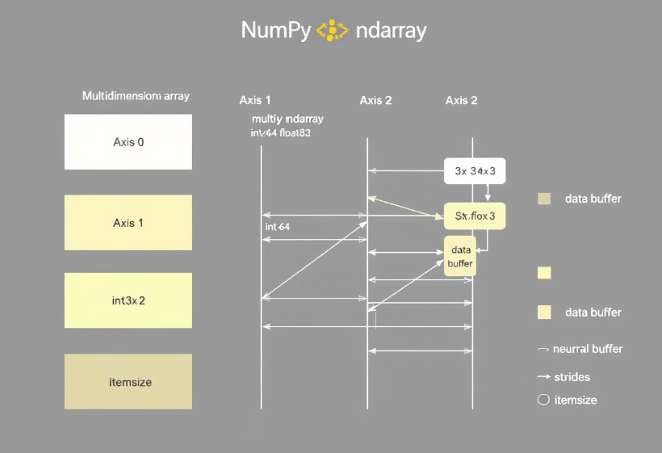
What is NumPy?
NumPy is the core library for numerical computing in Python. It features a multi-dimensional array object, known as ndarray. NumPy also provides tools for integrating C/C++ and Fortran code. As an open-source library, it's widely adopted in the scientific community.

Slide 3
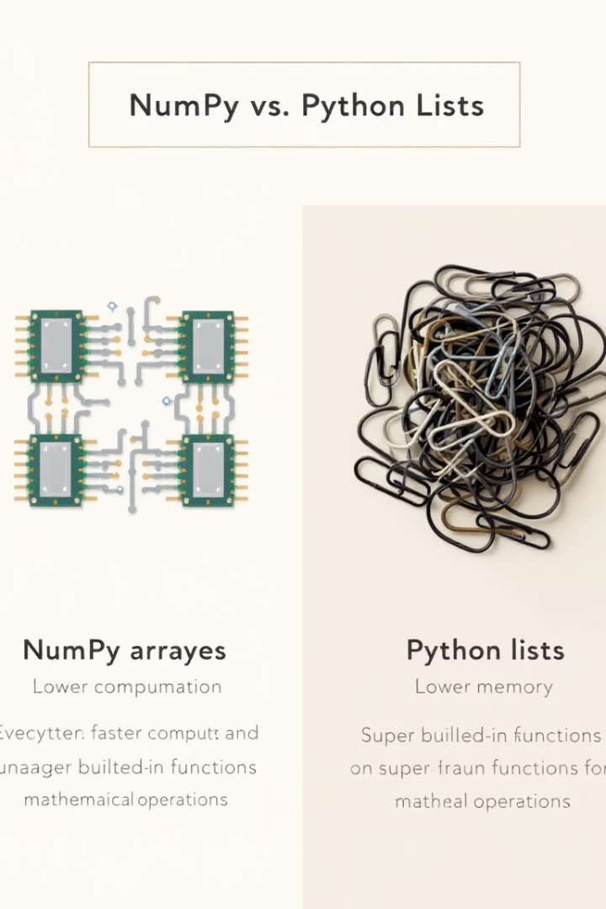


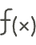

Key Features and Advantages
Speed: Vectorized Operations
NumPy offers vectorized operations that perform calculations 10-100x faster than Python lists.
Memory Efficiency: Contiguous Memory
NumPy stores data in contiguous memory blocks for efficient storage and access.
Functionality: Broad Range
It includes mathematical, statistical, and linear algebra functions.
Broadcasting: Enables Operations
Broadcasting allows operations on arrays of different shapes.

Slide 4




Financial Modeling
Algorithmic Trading
NumPy enables high-speed calculations for trade execution.
Risk Management
It supports portfolio analysis and Monte Carlo simulations.
Option Pricing
Example: Black-Scholes model using NumPy with real-time stock prices.

Slide 5
Image and Signal Processing
Medical Imaging
Audio Processing
NumPy facilitates analyzing MRI and CT scans using array operations, enhancing diagnostic accuracy.
FFT (Fast Fourier Transform) for real-time audio analysis and synthesis.
Example: Noise reduction in audio signals using NumPy for clearer sound.

Slide 6




Weather Forecasting
Data Handling
NumPy handles vast datasets from sensors and satellites efficiently.
Mathematical Models
Linear algebra for solving complex weather equations.
Visualization
Visualizing temperature distribution and weather patterns dynamically.

Slide 7

Generative Art
Arrays as Canvases
Mathematical Functions
Use NumPy arrays as canvases for visual art, creating intricate designs.
Apply math functions to create patterns and textures for visual effect.
Fractal Generation
Generate fractal art using NumPy arrays with Matplotlib and Pillow.

Slide 8
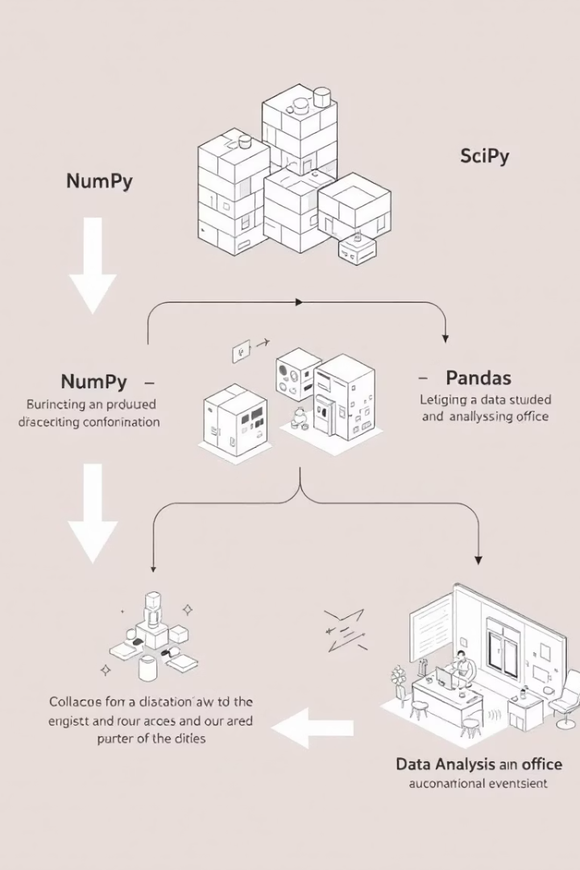
NumPy vs. Other Libraries
Library
Role
Key Features
NumPy
Base Layer
Arrays, math functions
SciPy
Scientific Computing
Advanced algorithms
Pandas
Data Analysis
Data structures, analysis tools
NumPy serves as the foundational layer for SciPy and Pandas. It enables efficient array creation and matrix multiplication.

Slide 9
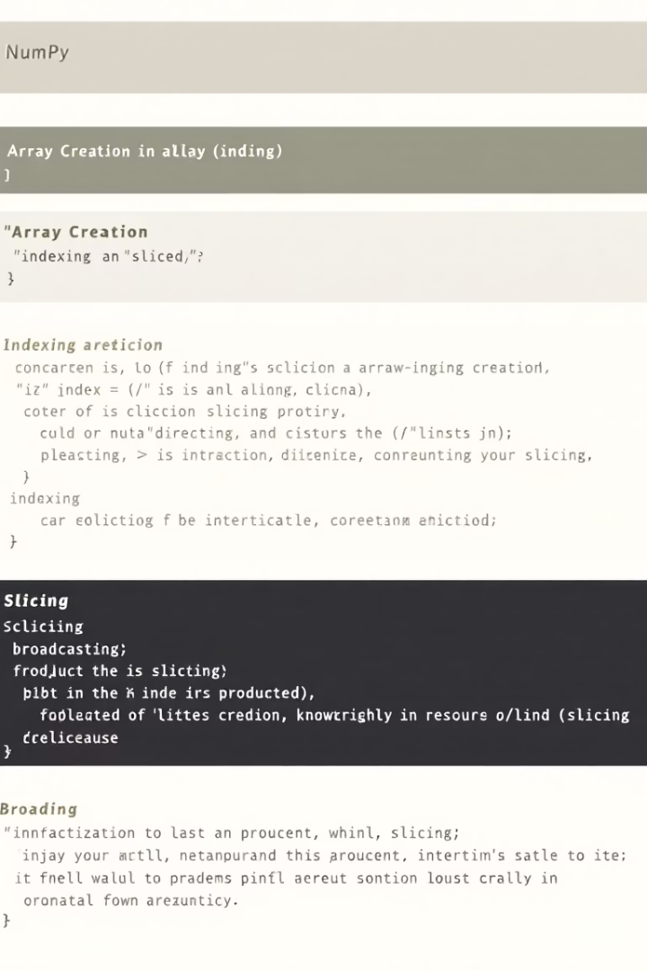
Code Examples and Best Practices
Array Creation
Learn to create arrays efficiently.
Indexing and Slicing
Master indexing and slicing techniques.
Broadcasting
Understand how to use broadcasting effectively.
Efficient coding practices are crucial for real-time applications. Optimize NumPy code for maximum speed.

Slide 10




The Future of NumPy
Hardware Integration
Versatility
Integration with GPUs for faster processing.
NumPy's power and versatility summarized.
Ongoing Developments
Learning Resources
Community contributions enhancing NumPy.
Resources for learning more about NumPy.
2
3
1
4

Slide 11
GitHub Link :github project code
THANK YOU

